Slide 1

Intro to Javascript
Introduction to Frontend Web Design
Notes:
Welcome back. Today we’ll be talking about the moment you’ve all been waiting for.

Slide 2
Agenda
What is Programming?
History of Javascript
Intro to Javascript
Q&A
Hello World
Notes:
. Today we dive into dynamic web sites. What do I mean by this?
Well in general what we’ve learned so far is static in many ways. HTML is declarative. What you see is what you get. Same with CSS. You define what box’s relationships from each other. What we’re going to embark on today is Javascript which is a high level programming language.

Slide 3
An Intro to Programming
Notes:
What is programming exactly?

Slide 4
Programming n. – The action of writing a computer program.
Notes:
According to the dictionary, programming is the action of writing a computer program.
Ok that’s kind of useless. Let’s look up program

Slide 5
Program v. – To give coded instructions to a machine for automatic performance of a particular task
Notes:
To give a computer instructions for automatic performance of said task. We can already sort of see the difference between CSS and HTML. Those are declarative and in some ways like writing an abstract paper. They are very specific ways of getting a computer to display something.
My definition for programming is this:

Slide 6
Programming n. – The act of giving a computer instructions for how to solve a specific problem.
Notes:
The act of giving instructions to a computer to automate or solve a specific problem. Let’s go with an analogy.

Slide 7

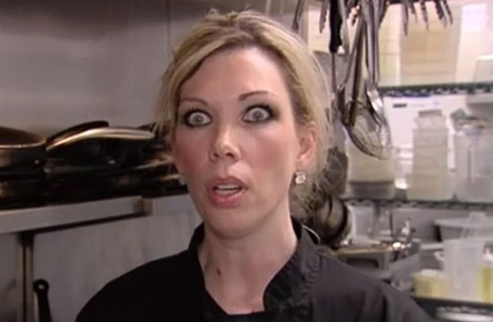
Gordan Ramsay – All around smart person
Amy – All around clueless person
Notes:
I’m not sure how many of you have watched Hell’s Kitchen. I myself haven’t. But from what I’ve heard it’s basically an excuse for Gordan Ramsay to yell at people. It’s a cooking competition show. One of the contestants was Amy, who was especially clueless. This isn’t to say she was bad at cooking. She was very good at specific instructions for how to cook, like say mixing or fold. But she was very very bad at making her own recipes. This is where Gordan would step in and yell or give recipes that Amy would follow.

Slide 8
You, the programmer – All around smart person
Computer – really kinda dumb
Notes:
Well in this example you, the programmer are Gordan Ramsay. Amy is the computer. It’s so weird to think about how antithetical to most people’s worldview this is. Most people imagine that the computer is smart all knowing and incomprehensible. They’re wrong. Computers are dumb. They are capable of following only the simplest actions. But what you can do is you can write instructions for more complex actions. And then combine those actions into something more complex still. It’s like teaching someone to knead dough for example. You start off with a ball of dough. You press. You turn. You fold. You repeat. At that point you’ve defined a more complex action that you can now use in a future instruction set.

Slide 9
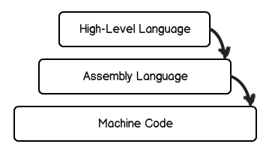
Notes:
Well this is exactly like a programming language. The lowest rung are the instructions that a machine can understand.

Slide 10
Binary – 0, 1
Notes:
These are the only thing a machine knows how to do. It can literally only understand 0 and 1 (and groups of 0’s and 1’s). And all a 0 means is False and 1 is True.
We formed more complex instructions when we introduced Assembly Language

Slide 11
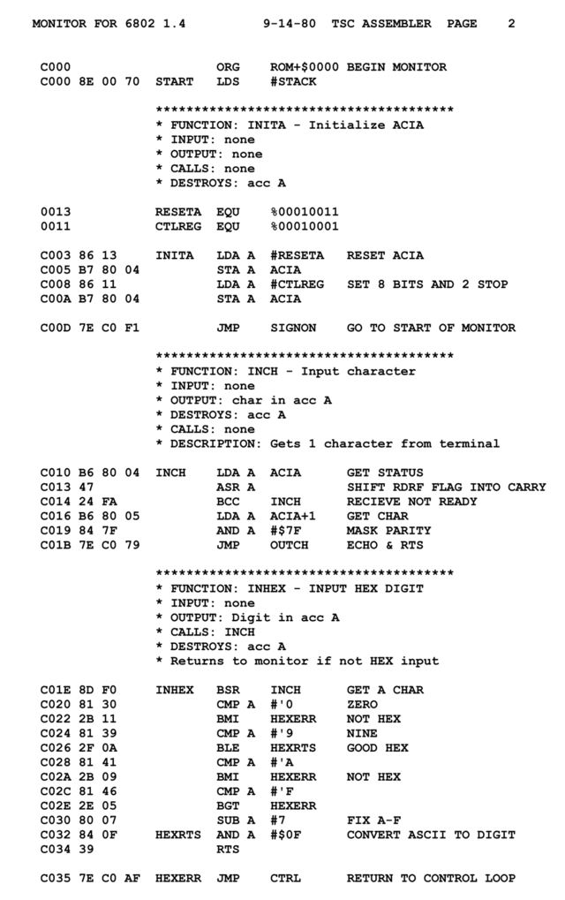
Notes:
Assembly language is something slightly more complex. It’s human readable and it’s made up of rudimentary instructions like move this value here, move this value out of here etc. It allowed us to create even more complex instruction set. This is what Javascript is.

Slide 12
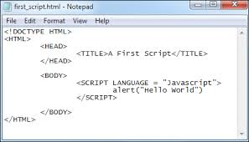
Notes:
Javascript is a high level programming language. It’s a complex instruction set that both humans and computers can understand. It’s existence allows us to solve more complex problems on the web.

Slide 13
History of Javascript
Invented in 10 days by Netscape
Created as a nonprofessional language named Livescript
Renamed to Javascript to remind people that Java existed
Notes:
JS was invented in 10 days by Netscape. It was created as a lightweight program that was designed to appeal to non professional programmers. It was released in 95 as Livescript before being renamed to Javascript to remind people about Java’s existence. But the two languages are nothing alike other than some cosmetic similarities.

Slide 14
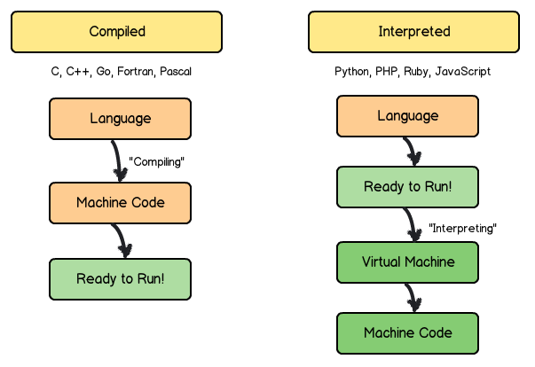
Notes:
For one thing, JS is an interpreted language where Java is compiled. What this means is that lines of code are read and executed on the fly and as needed rather than having to be compiled down to machine code. This has implications for its overall performance.

Slide 15
What’s JS used for
Button presses
Image switching
Communicating with the server to fetch additional information
Graphical rendering
Manipulating the DOM
Other cool stuff
Notes:
What’s Javascript used for? It’s for designing interactions. For example if I push a button on a web site what will it do? More than likely there’s a script that runs. It runs on light boxes so when you click a picture, a bigger image will show up. It might run on Google maps for example when you drag the map around and a gray box slowly fills in with more maps. It’s used to remove DOM elements from the page and put new ones in. In short, it’s ubiquitous.

Slide 16
What is Javascript?
A high level programming language
An interpreted language
An instruction set for creating dynamic web pages
A necessary part to learning and understanding front end web design.
Notes:
So what is Javascript? It’s a high level programming language used to program interactions. It’s made specifically to power web pages while being simple to learn. And it’s so necessary to the web experience today.
Any questions before we jump into exercises?

Slide 17
Q&A

